Slide 2
Topics
The if Statement
The if-else Statement
Comparing Strings
Nested Decision Structures and the if-elif-else Statement
Logical Operators
Boolean Variables
Conditional Expressions
Assignment Expressions and the Walrus Operator

Slide 3
The if Statement
Control structure: logical design that controls order in which set of statements execute
Sequence structure: set of statements that execute in the order they appear
Decision structure: specific action(s) performed only if a condition exists
Also known as selection structure

Slide 4
The if Statement (cont’d.)
In flowchart, diamond represents true/false condition that must be tested
Actions can be conditionally executed
Performed only when a condition is true
Single alternative decision structure: provides only one alternative path of execution
If condition is not true, exit the structure

Slide 5
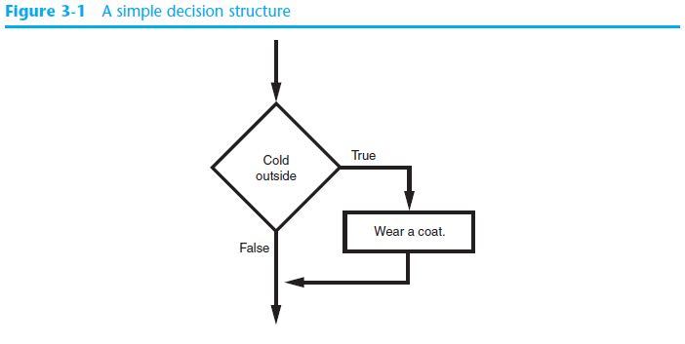
The if Statement (cont’d.)

Slide 6
The if Statement (cont’d.)
Python syntax:
if condition:
Statement
Statement
etc…
First line known as the if clause
Includes the keyword if followed by condition
The condition can be true or false
When the if statement executes, the condition is tested, and if it is true the block statements are executed. otherwise, block statements are skipped

Slide 7
Boolean Expressions and Relational Operators
Boolean expression: expression tested by if statement to determine if it is true or false
Example: a > b
true if a is greater than b; false otherwise
Relational operator: determines whether a specific relationship exists between two values
Example: greater than (>)

Slide 8
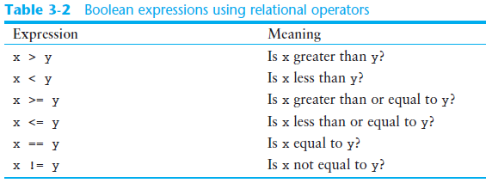
Boolean Expressions and Relational Operators (cont’d.)

Slide 9
Single-Line if Statements
An if statement can be written on a single line if it executes only one statement.
Python syntax:
if condition: statement
Example:
if score > 59: print('You passed!')

Slide 10
The if-else Statement
Dual alternative decision structure: two possible paths of execution
One is taken if the condition is true, and the other if the condition is false
Syntax: if condition:
statements
else:
other statements
if clause and else clause must be aligned
Statements must be consistently indented

Slide 11
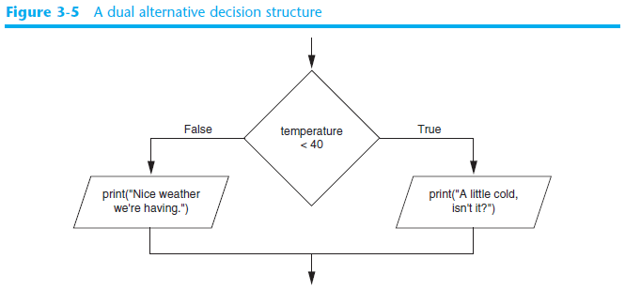
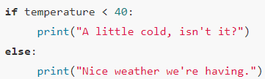
The if-else Statement (cont’d.)

Slide 12
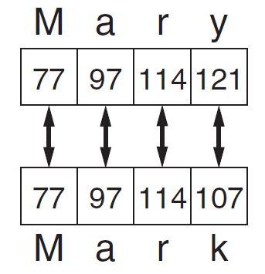
Comparing Strings
Strings can be compared using ==, !=, >, <, >=, and <=
Compared character by character based on the ASCII values for each character
If shorter word is substring of longer word, longer word is greater than shorter word

Slide 13
Nested Decision Structures
A decision structure can be nested inside another decision structure
Commonly needed in programs
Example:
Determine if someone qualifies for a loan, they must meet two conditions:
Must earn at least $30,000/year
Must have been employed for at least two years
Check first condition, and if it is true, check second condition

Slide 14
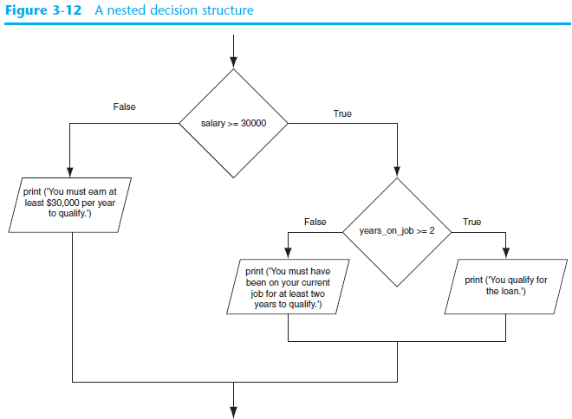
Nested Decision Structures

Slide 15
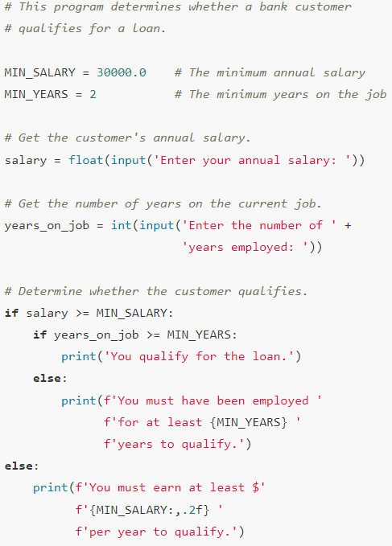
Nested Decision Structures

Slide 16
The if-elif-else Statement
if-elif-else statement: special version of a decision structure
Makes logic of nested decision structures simpler to write
Can include multiple elif statements
Syntax:
if condition_1:
statement(s)
elif condition_2:
statement(s)
elif condition_3:
statement(s)
else
statement(s)
Insert as many elif clauses
as necessary.

Slide 17
The if-elif-else Statement
Alignment used with if-elif-else statement:
if, elif, and else clauses are all aligned
Conditionally executed blocks are consistently indented
if-elif-else statement is never required, but logic easier to follow
Can be accomplished by nested if-else as discussed before
Code can become complex, and indentation can cause problematic long lines

Slide 18
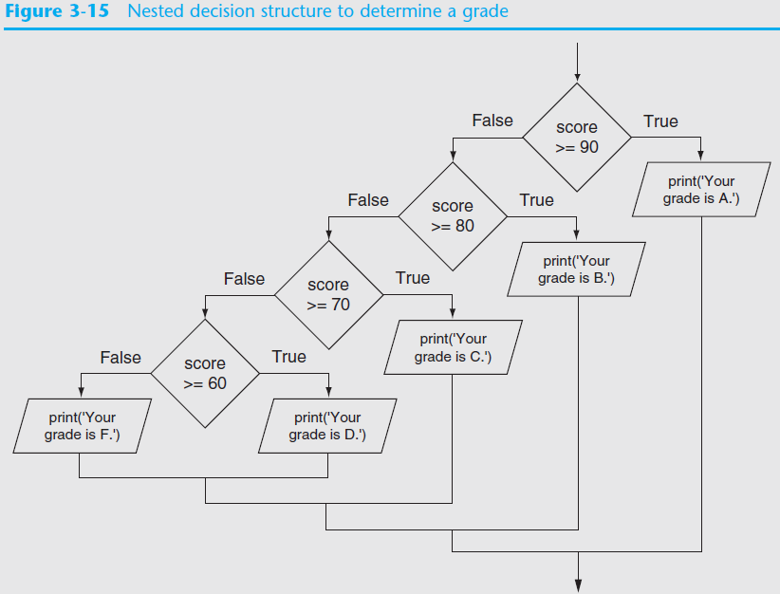
The if-elif-else Statement

Slide 19
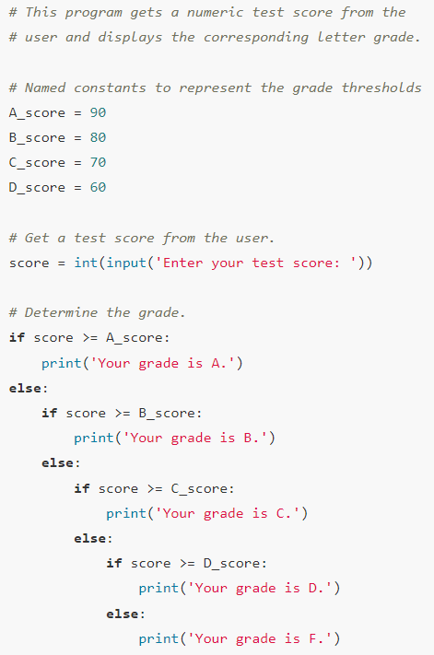
The if-elif-else Statement

Slide 20
Logical Operators
Logical operators: operators that can be used to create complex Boolean expressions
and operator and or operator: binary operators, connect two Boolean expressions into a compound Boolean expression
not operator: unary operator, reverses the truth of its Boolean operand

Slide 21
The and Operator
Takes two Boolean expressions as operands
Creates compound Boolean expression that is true only when both sub expressions are true
Can be used to simplify nested decision structures
Truth table for
the and operator
Value of the Expression | Expression
false | false and false
false | false and true
false | true and false
true | true and true

Slide 22
The or Operator
Takes two Boolean expressions as operands
Creates compound Boolean expression that is true when either of the sub expressions is true
Can be used to simplify nested decision structures
Truth table for
the or operator
Value of the Expression | Expression
false | false and false
true | false and true
true | true and false
true | true and true

Slide 23
Short-Circuit Evaluation
Short circuit evaluation: deciding the value of a compound Boolean expression after evaluating only one sub expression
Performed by the or and and operators
For or operator: If left operand is true, compound expression is true. Otherwise, evaluate right operand
For and operator: If left operand is false, compound expression is false. Otherwise, evaluate right operand

Slide 24
The not Operator
Takes one Boolean expressions as operand and reverses its logical value
Sometimes it may be necessary to place parentheses around an expression to clarify to what you are applying the not operator
Truth table for the not operator
Value of the Expression | Expression
false | true
true | false

Slide 25
Checking Numeric Ranges with Logical Operators
To determine whether a numeric value is within a specific range of values, use and
Example: x >= 10 and x <= 20
To determine whether a numeric value is outside of a specific range of values, use or
Example: x < 10 or x > 20

Slide 26
Logical Operators - Example
A bank determines if a customer qualifies for a loan if they meet the following two conditions:
Salary is at least $30000
They have been at their job for at least two years

Slide 27
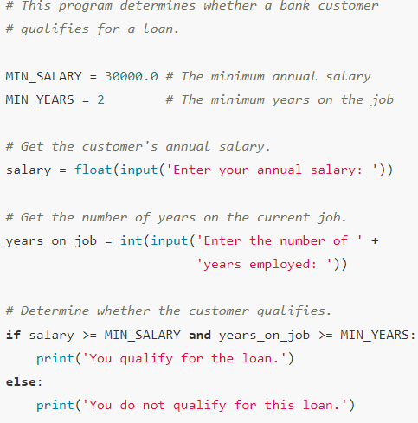
Logical Operators - Example

Slide 28
Logical Operators - Example
Now, let’s say that the bank needs to make more money.
So, they relax their loan requirements.
A customer may meet only one of the two conditions to get a loan:
Salary is at least $30000
They have been at their job for at least two years

Slide 29
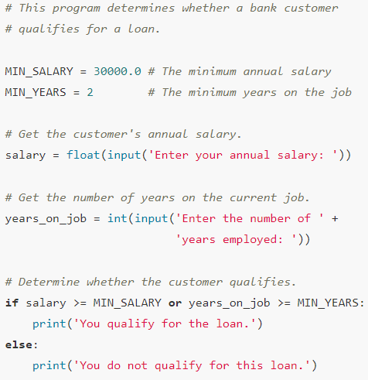
Logical Operators - Example

Slide 30
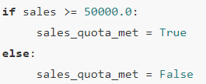
Boolean Variables
Boolean variable: references one of two values, True or False
Represented by bool data type
Commonly used as flags
Flag: variable that signals when some condition exists in a program
Flag set to False → condition does not exist
Flag set to True → condition exists

Slide 31
Conditional Expressions
Conditional expressions are ternary operator that can be used to create short expressions that work like if-else statements.
Syntax:
value_1 if condition else value_2
condition is a Boolean expression that is tested
If condition is true, the expression gives us value_1
If condition is false, the expression gives us value_2

Slide 32
Conditional Expressions
Example: grade = 'Pass' if score > 59 else 'Fail'
If score is greater than 59, grade is assigned 'Pass'. Otherwise, grade is assigned 'Fail'.
Equivalent to:
if score > 59: grade = 'Pass'
else:
grade = 'Fail'

Slide 33
The Walrus Operator
The walrus operator := is an enhanced assignment operator
You use the walrus operator to create assignment expressions that does two things:
It assigns a value to a variable
It returns the value that was assigned to the variable

Slide 34
The Walrus Operator
Example: print(num := 99)
This statement does two things:
It assigns 99 to the num variable
It prints the value that was assigned to the num variable, 99

Slide 35
The Walrus Operator
Example: if (pay := hours * pay_rate) > 40: print('You worked overtime')
This if statement does the following:
The pay variable is assigned the value of hours * pay_rate
If the value that was assigned to pay is greater than 40, the message You worked overtime is displayed.

Slide 36
The Walrus Operator
Precedence of the walrus operator
The walrus operator has the lowest precedence of all the operators in Python
When using the walrus operator in a larger expression that also uses other operators, the walrus operator will work last
In most cases, you need to put parentheses around the assignment expression to make sure the walrus operator assigns the correct value to its variable
if (pay := hours * pay_rate) > 40
Without the parenthesis, > operator is evaluated before the Walrus operator resulting in pay having a true or false value

Slide 37
The Walrus Operator
An assignment expression using the Walrus operator is not a complete statement on its own
For example, this alone causes an error: num := 99
It must be written as part of a larger statement print(num := 99)

Slide 38
Summary
This chapter covered:
Decision structures, including:
Single alternative decision structures
Dual alternative decision structures
Nested decision structures
Relational operators and logical operators as used in creating Boolean expressions
String comparison as used in creating Boolean expressions
Boolean variables
Walrus Operator

